Slide 1
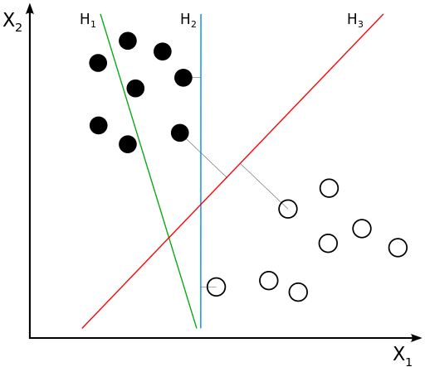
SVM Method
Classifying data is a common task in machine learning. Suppose some given data points each belong to one of two classes, and the goal is to decide which class a new data point will be in.
H₁ does not separate the classes. H₂ does, but only with a small margin. H₃ separates them with the maximum margin.

Slide 2
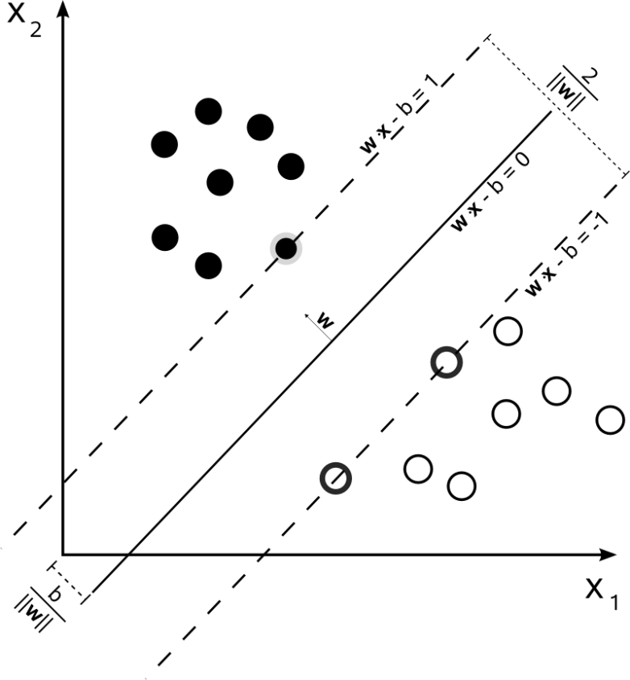
SVM Method
Maximum-margin hyperplane and margins for an SVM trained with samples from two classes. Samples on the margin are called the support vectors

Slide 3
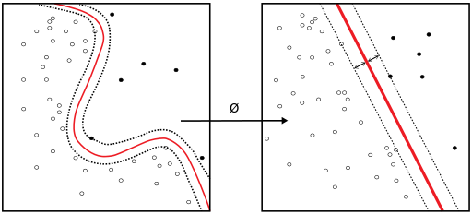


SVM Algorithms
Linear kernel
Polynomial Kernel
RBF Kernel
Sigmoid Kernel

Slide 4
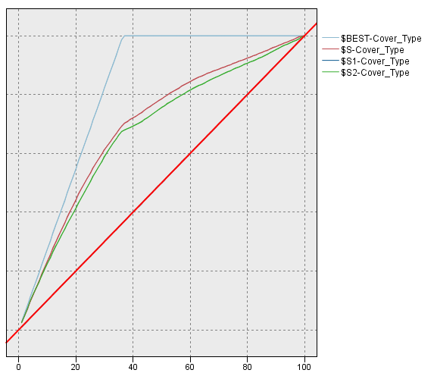
Compare the algorithms
Model | Linear | RBF γ=0.1 | sigmoid
Accuracy | 0.608 | 0.637 | 0.0299
gain at 20% | 42.15% | 44.23% | \

Slide 5
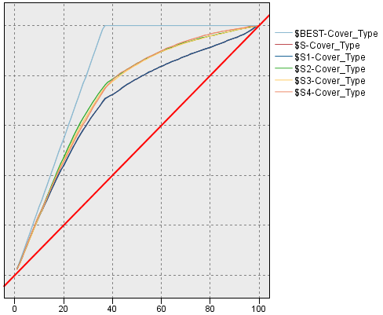
Compare the algorithms
RBF | γ=0.1 | γ=1 | γ=10 | γ=20 | γ=50
Accuracy | 0.642 | 0.642 | 0.743 | 0.755 | 0.758
gain at 20% | 44.08 | 44.08 | 47.581 | 47.262 | 47.182
Better Models

